Slide 1
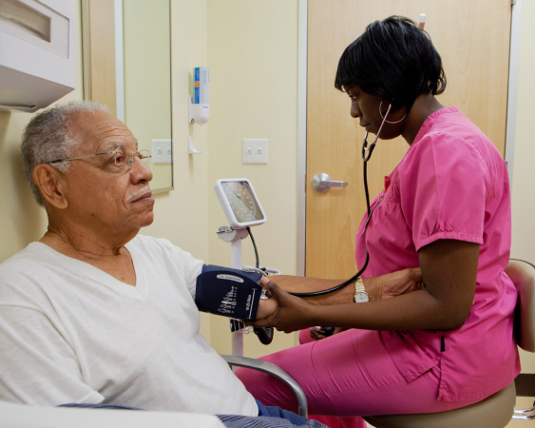

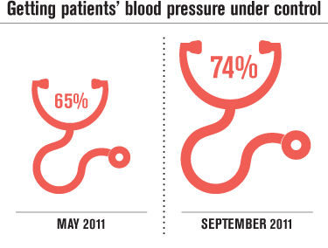
Better workflow helps control blood pressures
WHAT THEY DID
This UBT in Largo, Md., got more hypertensive patients’ blood pressure under control by:
developing specialized scripts for the clinical nursing assistants (CNAs), who manage the schedule for blood pressure checks and make outreach calls to patients with hypertension
developing scripts for the receptionists, who make appointment reminder calls
sending patients with elevated blood pressure to nurse practitioners for management
referring patients with complex blood pressure medication management for additional consultation
Visit LMPartnership.org for ideas and tools for your team.

